Slide 1

Visual Studio 2010 and .NET Framework 4 Training Workshop

Slide 2
Presentation Outline (hidden slide):
Technical Level: 300
Intended Audience: Developers & Architects
Objectives (what do you want the audience to take away):
Understand Web Deployment improvements coming to Visual Studio 2010
Presentation Outline:
Review configuration in ASP.NET and IIS
Transforming settings in web.config
Packaging applications for deployment
Deploying packages to IIS
Once-click Deployment

Slide 3

Web Deployment With Visual Studio 2010
Name
Title
Organization
Email
Notes:
ESTIMATED TIME:
45 minutes

Slide 4
Agenda
Review configuration in ASP.NET and IIS
Transforming settings in web.config
Packaging applications for deployment
Deploying packages to IIS
Once-click Deployment

Slide 5
ASP.NET and IIS Configuration
Configuration stored in XML files validated by a schema.
Schema
Schema describes configuration settings for IIS, ASP.NET and 3rd party applications.
Validation
applicationHost.config
Central configuration file for the server contains system wide configuration settings.
web.config
web.config
Distributed configuration files contain overrides and local site and application settings.

Slide 6


Review configuration in ASP.NET and IIS

Slide 7
Web Deployment Today
Multiple environments including Development, Testing, Staging and Production
Must manage settings for each environment
Difficult to keep environments consistent
Applications often need to be deployed by someone else
Need to package code, data, application settings and environment configuration for easier deployment

Slide 8
What are the components, settings, etc you have to deploy with your web application?

Slide 9
Managing Settings
Need consistent configuration with customizations across deployment environments
Having multiple web.config files introduces inconsistencies
Web.config transformations allows one master web.config with specific customizations for target environments

Slide 10
How it Transformation Works
Web.
config
Web.
Staging.
config
<appSettings>
<add key="EnvironmentName" value="Staging"
xdt:Transform="SetAttributes(value)"
xdt:Locator="Match(key)" />
</appSettings>
<connectionStrings>
<add name="LoggingConnectionString"
connectionString=“connection"
providerName="System.Data.SqlClient"
xdt:Transform="Replace"
xdt:Locator="Match(name)" />
</connectionStrings>
Deployed
Web.
config
Visual Studio
Transformation

Slide 11
Web.Config Transformation
Transform | Description
xdt:Transform=“Replace” | Replaces the first matched node
xdt:Transform=“Remove” | Removes the first matched node
xdt:Transform=“RemoveAll” | Removes all the matching nodes
xdt:Transform=“Insert” | Inserts the node at the end
xdt:Transform=“SetAttributes(attributeNames)” | Creates or changes values of the existing attributes
xdt:Transform=“RemoveAttributes(attributeNames)” | Removes the attributes if they exist
xdt:Transform=“InsertBefore(XPath)” | Inserts the node on the provided Xpath
xdt:Transform=“InsertAfter(XPath)” | Inserts the node on the provided XPath

Slide 12
Web.Config Transformation Locators
Locator | Description
xdt:Locator=“Match(attributeName)” | Can accept comma seperated names of the attributes
xdt:Locator=“Condition(xPath Predicate)” | Can take any Xpath predicates like xdt:Locator="Condition(@name=’Northwind’ or @providerName=’ System.Data.SqlClient’)"
xdt:Locator=“Xpath(/configuration/…)” | Can take any complicated Xpath like "XPath(//system.web)"

Slide 13
MS Deploy
Synchronize, Migrate, Deploy
Works with IIS 6.0 and IIS 7.0
Analyze the destination environment
Do a –whatif Analysis before committing operation
Includes a service for deploying applications remotely
Integration
Integrated with Powershell
Integrated in Visual Studio 2010
Compatible with Web Platform Installer

Slide 14
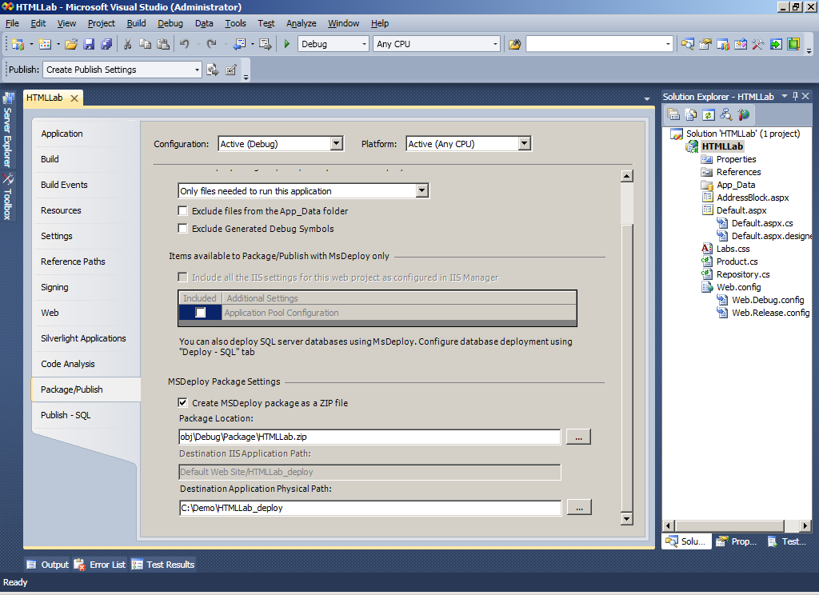
Integration with Visual Studio 2010

Slide 15
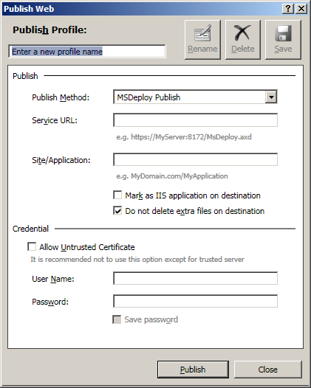
One-click Deployment
Leverages everything we’ve seen so far
Wraps multiple steps into a single click

Slide 16
Making Deployment Easier

